Slide 1

Dr. Aaron Garrett
Trent Ford
Sinh Nguyen
Andrew Green
Robert S. Warren, Jr.
Katie Wood

Slide 2

Contents
Features 1-4
Features 5-8
Features 9-12
API HOME Screenshot
Hyperlink Screenshot 1 API
Hyperlink Screenshot 2 API
Basic JavaCalculator Demo
Reading XML Demo
Writing XML Demo
Java Code Coverage Screenshot
Acceptance Test
Acceptance Test HTML screenshot
Links To Documents
Notes:
----- Meeting Notes (12/3/15 16:42) -----
Table of contents page

Slide 3
Features 1-4
Feature 1: Allow only string-valued positional arguments and retrieve them from the command-line.
Feature 2: Allow the inclusion of additional descriptive information on the program and each argument and provide named "-h" argument that shows usage and help information by default.
Feature 3: Allow datatype information to be added to arguments so that non-string arguments can be used.
Feature 4: Allow named arguments with single values, which may have help and datatype information, after all positional arguments.
Notes:
----- Meeting Notes (12/3/15 16:42) -----
We implemented features 1-12, here we will give a brief description of Features 1-4.

Slide 4
Features 5-8
Feature 5: Allow named arguments to be mixed with positional arguments in any order.
Feature 6: Allow named arguments to serve as flags (true if present).
Feature 7: Allow short-form names for named arguments, in addition to long-form names.
Feature 8: Throw exceptions if a specified argument does not exist or has the wrong datatype.
Notes:
----- Meeting Notes (12/3/15 16:42) -----
Here we have a brief description of features 5-8

Slide 5
Features 9-12
Feature 9: Allow argument information to be loaded from an XML file.
Feature 10: Allow argument information to be saved to an XML file.
Feature 11: Provide comprehensive documentation on library features, including examples of use. (API)
Feature 12: Allow arguments to have a restricted set of possible choices for their values.
Notes:
----- Meeting Notes (12/3/15 16:42) -----
Here we have a brief description of features 9-12. We will go into more detail on feature 11, as that is our API.

Slide 6
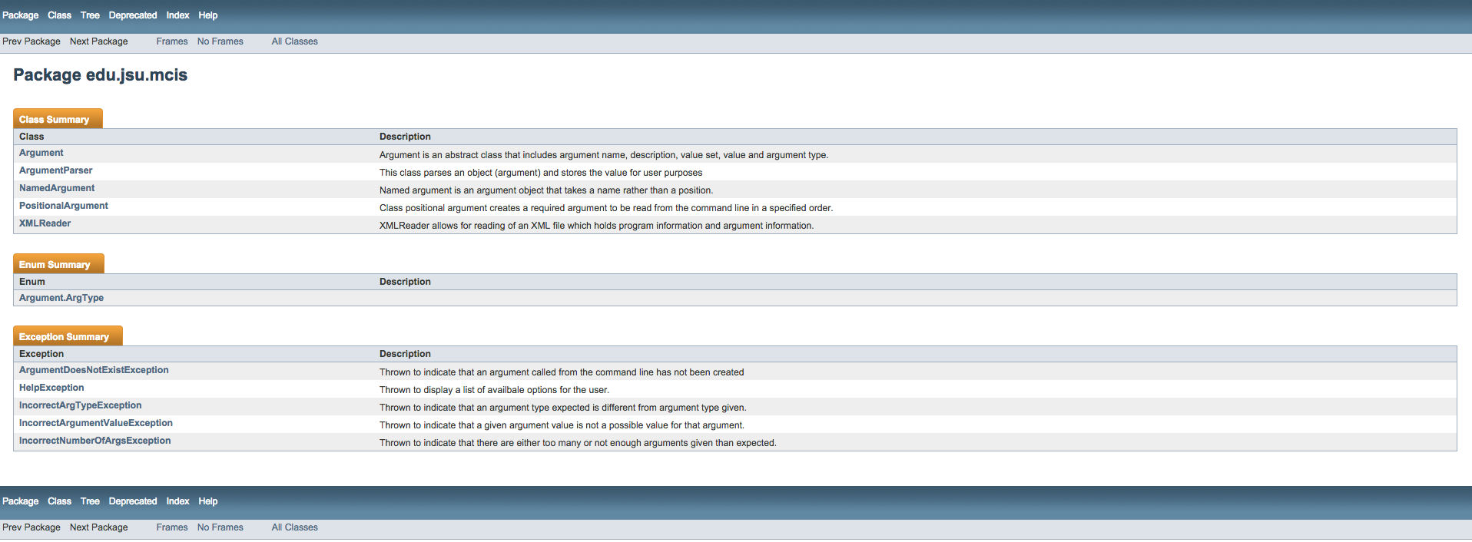
Api Main
After API
Notes:
----- Meeting Notes (12/3/15 16:42) -----
We added API documentation for Feature 11, and we use gradle (our build tool) to build our documentation.
This is what our API index page looks like. We will click one of the options to take a closer look.

Slide 7
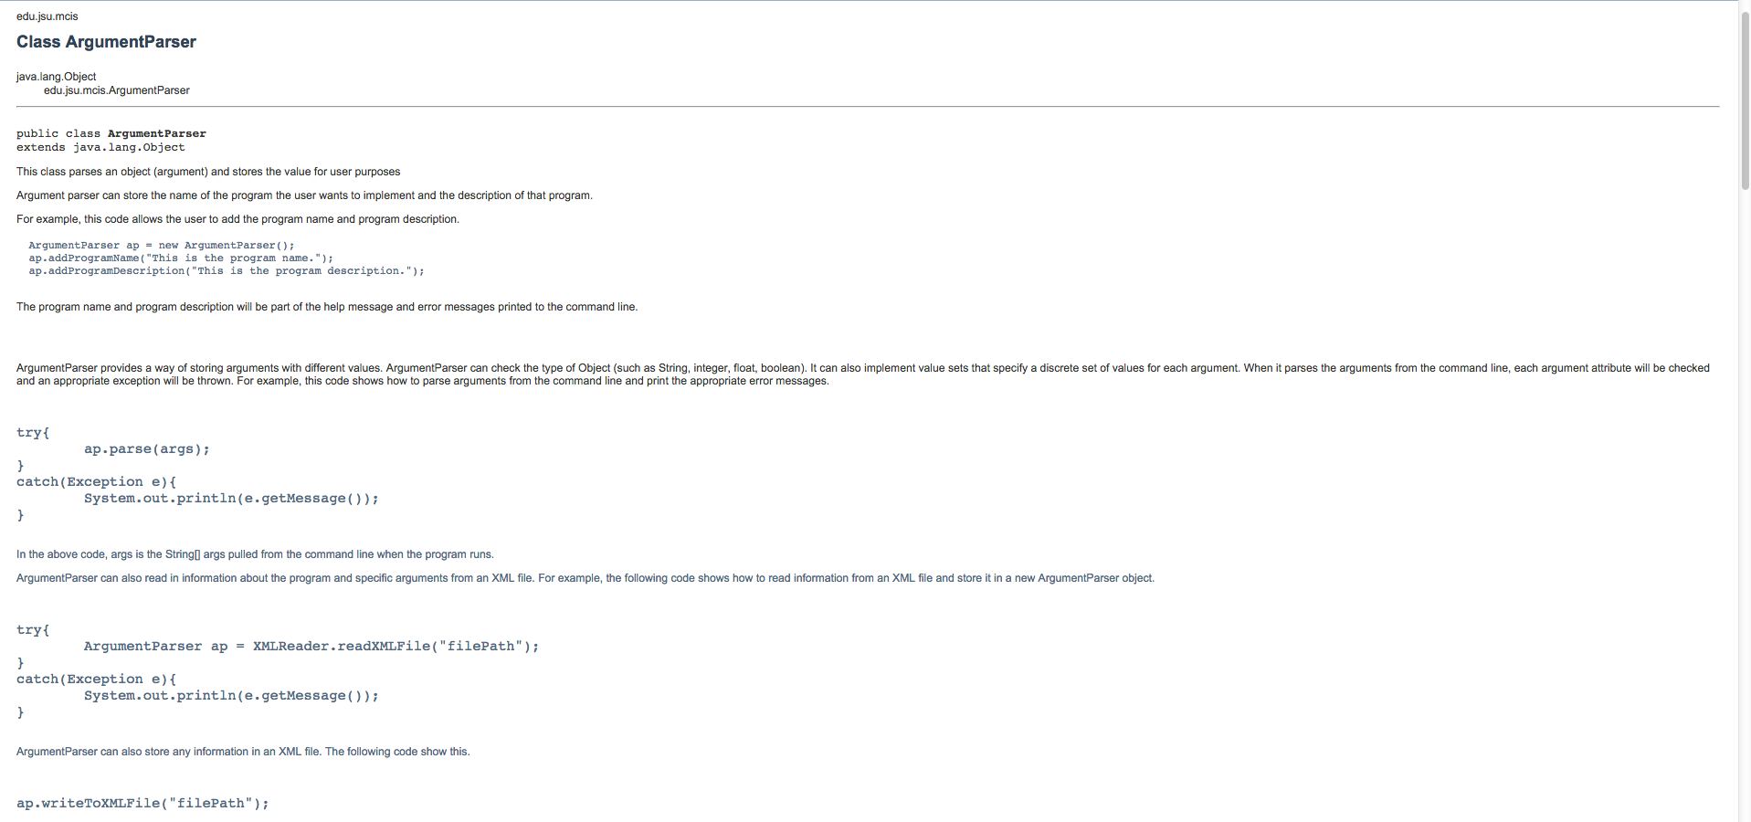
Hyperlink Screenshot 1 Api
API HOME
Notes:
----- Meeting Notes (12/3/15 16:42) -----
This is the (nameOfClass).
----- Meeting Notes (12/4/15 11:27) -----
This is the ArgumentParser Class.

Slide 8
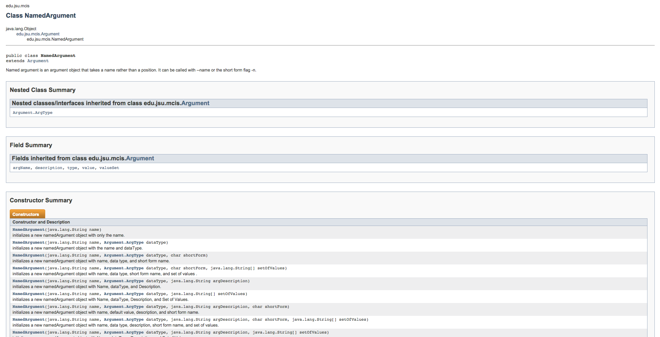
Hyperlink Screenshot 2 Api
API HOME
Notes:
----- Meeting Notes (12/3/15 16:42) -----
This is the (nameOfClass).
----- Meeting Notes (12/4/15 11:27) -----
This is the NamedArgument class

Slide 9
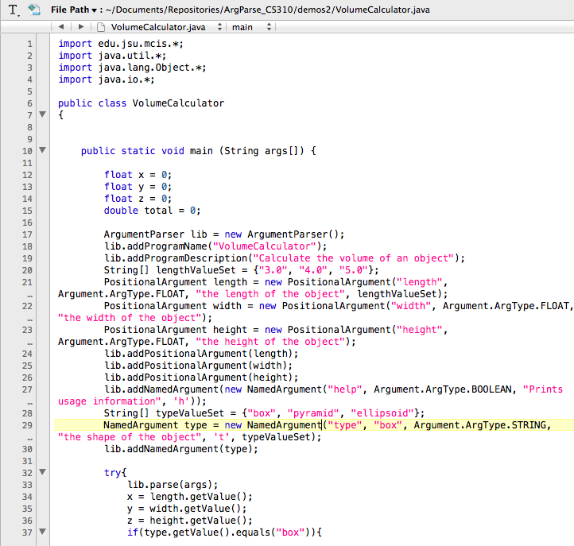
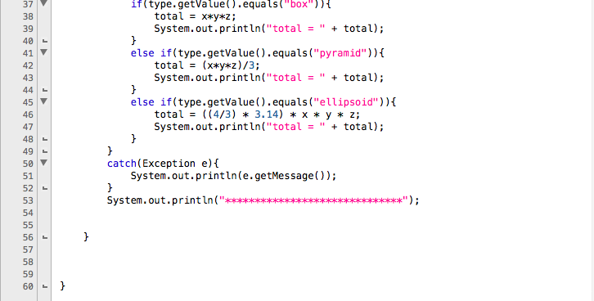
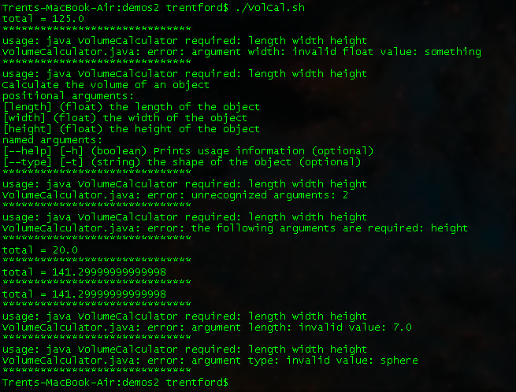
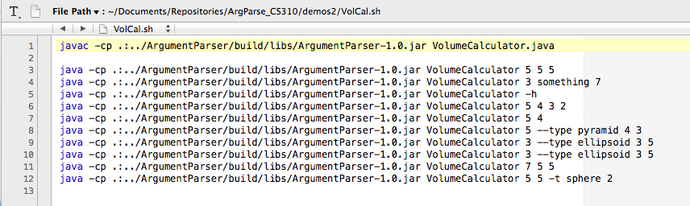
Basic JavaCalculator Demo
This is the demo
Here are the results
This is a shell file to run the demo with different arguments
Notes:
----- Meeting Notes (12/3/15 16:42) -----
This demo shows how our ArgParse library can be used basically from command line.

Slide 10
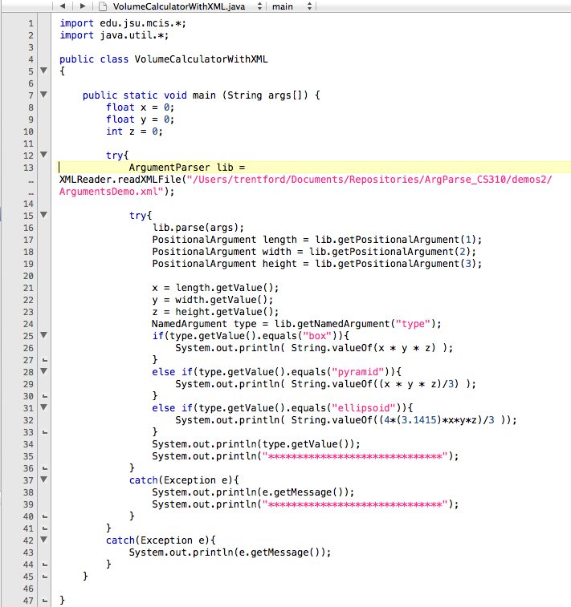
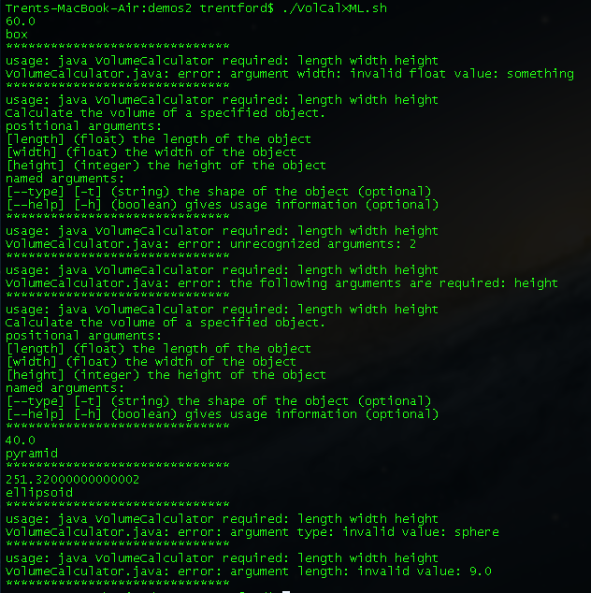
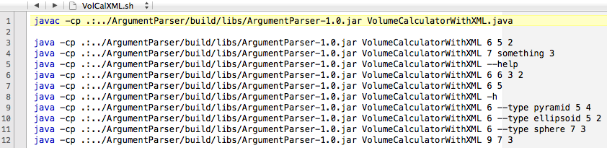
Reading XML Demo
This is the demo
This is a shell file to run the demo with different arguments
Here are the results →
Notes:
----- Meeting Notes (12/3/15 16:42) -----
This demo shows how our ArgParse library can read an XML file.

Slide 11
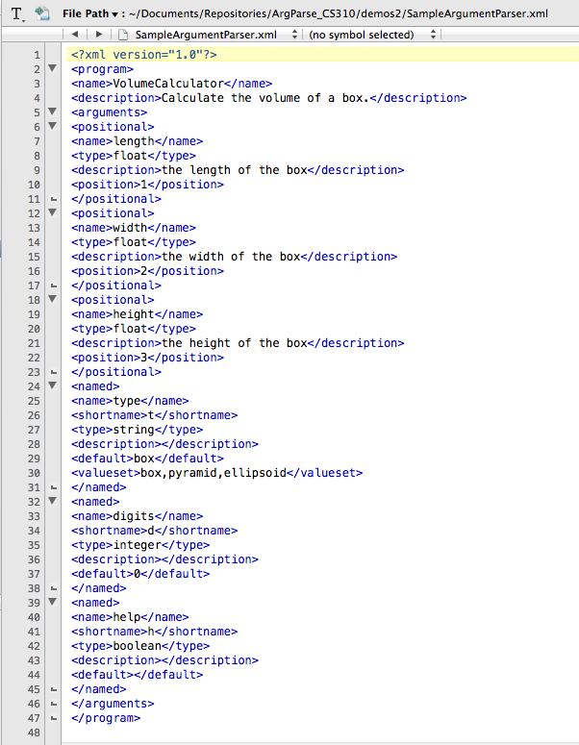
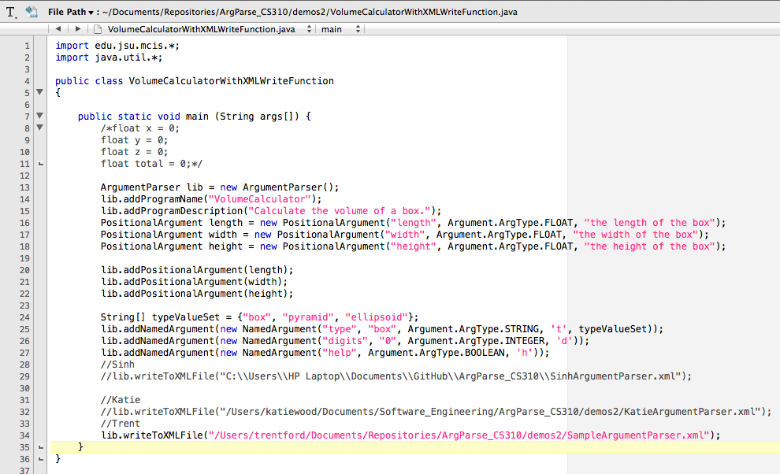

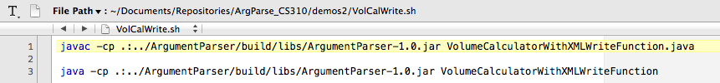
Writing XML Demo
This is a shell file to run the demo more easily
This is the demo
Here is the new xml file →
Notes:
----- Meeting Notes (12/3/15 16:42) -----
This demo shows how our ArgParse library can write to XML files

Slide 12
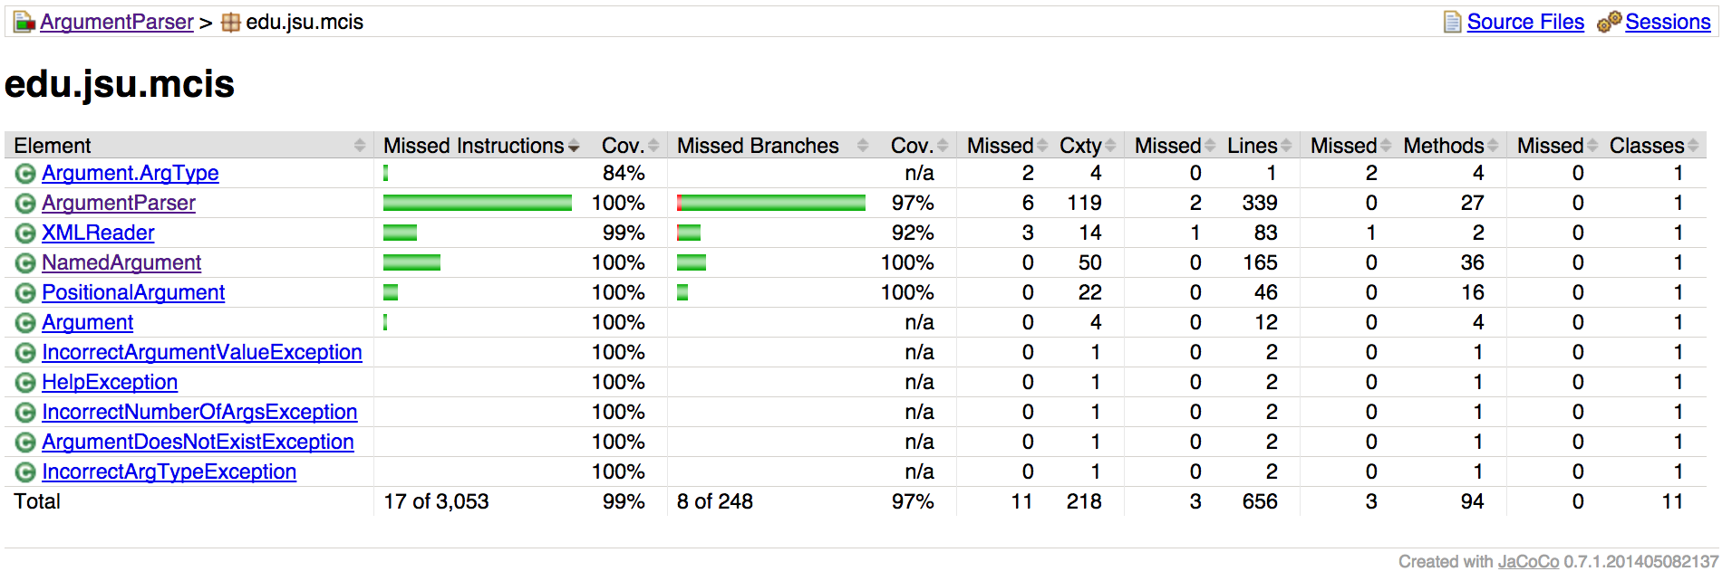
Java Code Coverage Screenshot
Notes:
----- Meeting Notes (12/3/15 16:42) -----
We used unit tests to keep our code correct, and our code coverage is at 99%

Slide 13
Acceptance Test
For visual reference
| *Setting* | *Value* |
| Library | ArgumentParserKeywords |
| *Variable* | *Value* |
| ${expected1} | usage: java Volume Calculator required: length width height\nVolume Calculator.java: error: unrecognized arguments: 43 |
| *Test Case* | *Action* | *Argument* | *Argument* | *Argument* | *Argument* |
| Test Volume Calculator Normal Function | Start Volume Calculator With Arguments | 7 | 5 | 2 | |
| | ${length}= | Get Length | | | |
| | Should Be Equal | 7 | ${length} | | |
| | ${width}= | Get Width | | | |
| | Should Be Equal | 5 | ${width} | | |
| | ${height}= | Get Height | | | |
| | Should Be Equal | 2 | ${height} | | |
| | ${output}= | Get Program Output | | | |
| | Should Be Equal | ${output} | 70.0 | | |
| Test Unrecognized Argument | Start Volume Calculator With Arguments | 7 | 5 | 2 | 43 |
| | ${output}= | Get Program Output | | | |
| | Should Be Equal | ${output} | ${expected1} | | |
| Test Absurd Program Normal Function | Start Absurd Program With Arguments | dog | 2 | true | 3.5 |
| | ${pet}= | Get Pet | | | |
| | Should Be Equal | dog | ${pet} | | |
| | ${number}= | Get Number | | | |
| | Should Be Equal | 2 | ${number} | | |
| | ${rainy}= | Get Rainy | | | |
| | Should Be Equal | true | ${rainy} | | |
| | ${bathrooms}= | Get Bathrooms | | | |
| | Should Be Equal | 3.5 | ${bathrooms} | | |
| *Variable* | *Value* |
| ${expected2} | usage: java Volume Calculator required: length width height\nCalculate the volume of a box.\npositional arguments:\n[length] (float) the length of the box (float)\n[width] (float) the width of the box (float)\n[height] (float) the height of the box (float)\nnamed arguments:\n[--help] [-h] (boolean) usage information (optional) |
| *Test Case* | *Action* | *Argument* | *Argument* |
| Test Usage Message | Start Program With Arguments | -h | |
| | ${output}= | Get Program Output | |
| | Should Be Equal | ${expected2} | ${output} |
| *Variable* | *Value* |
| ${expected3} | usage: java Volume Calculator required: length width height\nVolume Calculator.java: error: argument width: invalid float value: something |
| *Test Case* | *Action* | *Argument* | *Argument* | *Argument* |
| Test Incorrect Datatype Message | Start Program With Arguments | 7 | something | 2 |
| | ${output}= | Get Program Output | | |
| | Should Be Equal | ${output} | ${expected3} | |
| *Test Case* | *Action* | *Argument* | *Argument* | *Argument* | *Argument* | *Argument* | *Argument* | *Argument* |
| Test Named Argument Defaults | Start Volume Calculator With Arguments | 7 | 3 | 2 | | | | |
| | ${length}= | Get Length | | | | | | |
| | Should Be Equal | 7 | ${length} | | | | | |
| | ${width}= | Get Width | | | | | | |
| | Should Be Equal | 3 | ${width} | | | | | |
| | ${height}= | Get Height | | | | | | |
| | Should Be Equal | 2 | ${height} | | | | | |
| | ${type}= | Get Type | | | | | | |
| | Should Be Equal | box | ${type} | | | | | |
| | ${digits}= | Get Digits | | | | | | |
| | Should Be Equal | 4 | ${digits} | | | | | |
| Test Named Argument Single | Start Volume Calculator With Arguments | 7 | 3 | 2 | --type | ellipsoid | | |
| | ${length}= | Get Length | | | | | | |
| | Should Be Equal | 7 | ${length} | | | | | |
| | ${width}= | Get Width | | | | | | |
| | Should Be Equal | 3 | ${width} | | | | | |
| | ${height}= | Get Height | | | | | | |
| | Should Be Equal | 2 | ${height} | | | | | |
| | ${type}= | Get Type | | | | | | |
| | Should Be Equal | ellipsoid | ${type} | | | | | |
| | ${digits}= | Get Digits | | | | | | |
| | Should Be Equal | 4 | ${digits} | | | | | |
| Test Named Argument Multiple | Start Volume Calculator With Arguments | 7 | 3 | 2 | --type | ellipsoid | --digits | 1 |
| | ${length}= | Get Length | | | | | | |
| | Should Be Equal | 7 | ${length} | | | | | |
| | ${width}= | Get Width | | | | | | |
| | Should Be Equal | 3 | ${width} | | | | | |
| | ${height}= | Get Height | | | | | | |
| | Should Be Equal | 2 | ${height} | | | | | |
| | ${type}= | Get Type | | | | | | |
| | Should Be Equal | ellipsoid | ${type} | | | | | |
| | ${digits}= | Get Digits | | | | | | |
| | Should Be Equal | 1 | ${digits} | | | | | |
| *Test Case* | *Action* | *Argument* | *Argument* | *Argument* | *Argument* | *Argument* | *Argument* | *Argument* |
| Test Named Argument Anywhere | Start Volume Calculator With Arguments | --type | ellipsoid | 7 | 3 | --digits | 1 | 2 |
| | ${length}= | Get Length | | | | | | |
| | Should Be Equal | 7 | ${length} | | | | | |
| | ${width}= | Get Width | | | | | | |
| | Should Be Equal | 3 | ${width} | | | | | |
| | ${height}= | Get Height | | | | | | |
| | Should Be Equal | 2 | ${height} | | | | | |
| | ${type}= | Get Type | | | | | | |
| | Should Be Equal | ellipsoid | ${type} | | | | | |
| | ${digits}= | Get Digits | | | | | | |
| | Should Be Equal | 1 | ${digits} | | | | | |
| *Variable* | *Value* |
| ${expected4} | usage: java Volume Calculator required: length width height\nCalculate the volume of a box.\npositional arguments:\n[length] (float) the length of the box (float)\n[width] (float) the width of the box (float)\n[height] (float) the height of the box (float)\nnamed arguments:\n[--help] [-h] (boolean) usage information (optional) |
| *Test Case* | *Action* | *Argument* | *Argument* | *Argument* | *Argument* |
| Test Help Flag | Start Program With Arguments | 7 | --help | 3 | 2 |
| | ${output}= | Get Program Output | | | |
| | Should Be Equal | ${expected4} | ${output} | | |
| *Test Case* | *Action* | *Argument* | *Argument* | *Argument* | *Argument* | *Argument* | *Argument* | *Argument* |
| Test Short Form Arguments | Start Volume Calculator With Arguments | -t | ellipsoid | 7 | 3 | -d | 1 | 2 |
| | ${length}= | Get Length | | | | | | |
| | Should Be Equal | 7 | ${length} | | | | | |
| | ${width}= | Get Width | | | | | | |
| | Should Be Equal | 3 | ${width} | | | | | |
| | ${height}= | Get Height | | | | | | |
| | Should Be Equal | 2 | ${height} | | | | | |
| | ${type}= | Get Type | | | | | | |
| | Should Be Equal | ellipsoid | ${type} | | | | | |
| | ${digits}= | Get Digits | | | | | | |
| | Should Be Equal | 1 | ${digits} | | | | | |
Notes:
----- Meeting Notes (12/3/15 16:42) -----
Product Owner gave us specified Acceptance Tests to check if our Features were working the way he wants.
----- Meeting Notes (12/3/15 22:18) -----
The acceptance tests are long, so this is just for visual reference

Slide 14
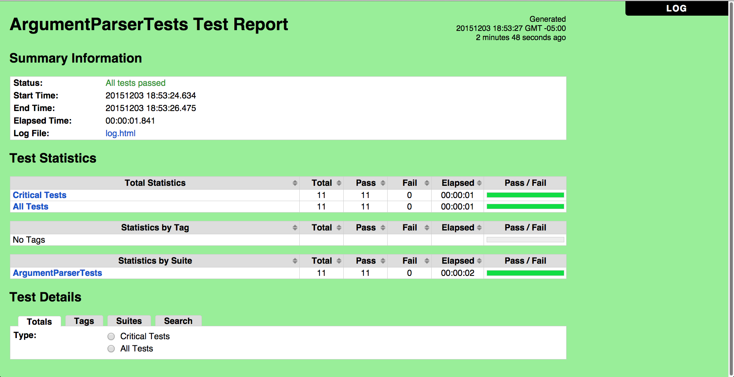
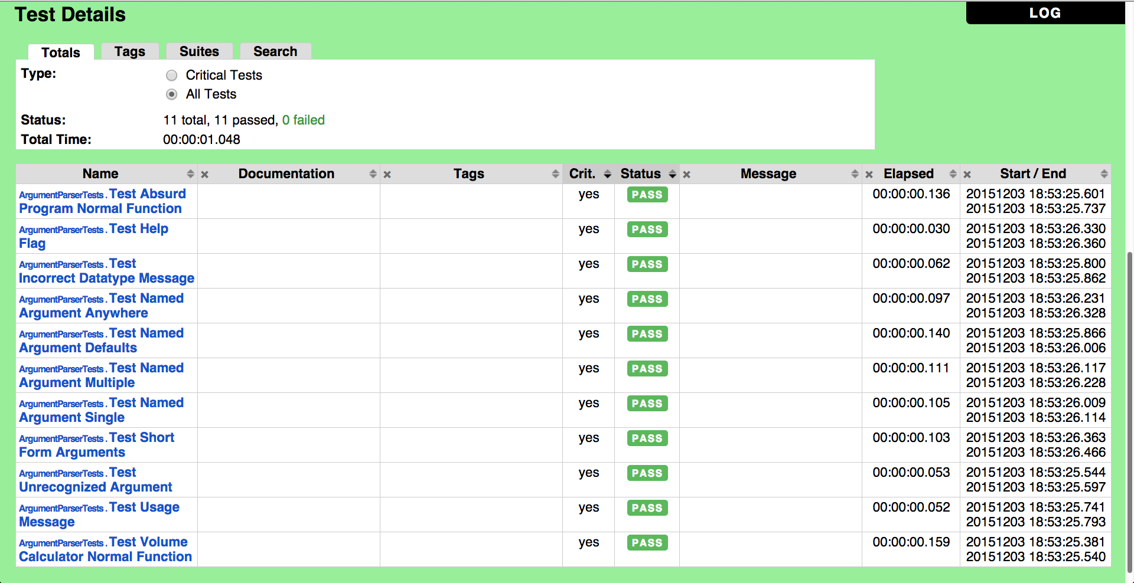
Acceptance Test HTML screenshot
Notes:
----- Meeting Notes (12/3/15 16:42) -----
We pass all the acceptance tests for the features we implemented.
----- Meeting Notes (12/3/15 22:18) -----
[on second picture]
And here is a slightly more detailed look

Slide 15
Links to Documents
Argument Parser
Argument
Help Exception
Acceptance Test Report*
XML Reader
Positional Argument
Source folder
Java Code Coverage Report*
API Home*
Unit Tests
Named Argument
Demos folder
Unit Tests Report*
*HTML files open to their source code on
Github. To view properly, download the file.
API Home
Notes:
----- Meeting Notes (12/3/15 16:42) -----
We can click on a button to open the corresponding document.

